Slide 1
Functions

Slide 2
What is a Function
A function is a self-contained block of statements that perform a task of some kind.
Every C program can be thought of as a collection of these functions.
The programming statements of a function are enclosed within { } braces.

Slide 3
Types of Functions
There are two types of functions in C programming:
Library Functions: are the functions which are declared in the C header files such as scanf(), printf(), gets(), puts(), ceil(), floor() etc.
User-defined functions: are the functions which are created by the C programmer, so that he/she can use it many times. It reduces the complexity of a big program and optimizes the code.

Slide 4
Syntax of Functions in C
The syntax of function can be divided into 3 aspects:
Function Declaration
Function Definition
Function Calls

Slide 5
Function Declarations
In a function declaration, we must provide the function name, its return type, and the number and type of its parameters.
Syntax
return_type name_of_the_function (parameter_1, parameter_2);
The parameter name is not mandatory while declaring functions.
Example
int sum(int a, int b);
int sum(int , int);

Slide 6
Function Definition
The function definition consists of actual statements which are executed when the function is called (i.e. when the program control comes to the function).
A C function is generally defined and declared in a single step because the function definition always starts with the function declaration so we do not need to declare it explicitly. The below example serves as both a function definition and a declaration.
return_type function_name (para1_type para1_name, para2_type para2_name) {
// body of the function
}

Slide 7
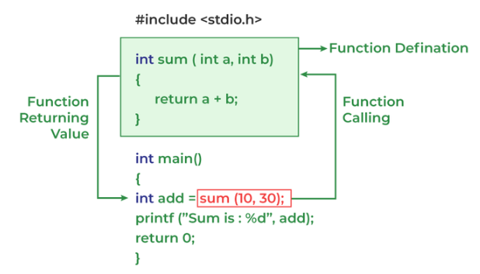
Function Call
A function call is a statement that instructs the compiler to execute the function. We use the function name and parameters in the function call.
In the below example, the first sum function is called and 10,30 are passed to the sum function. After the function call sum of a and b is returned and control is also returned back to the main function of the program.
Notes:
// C program to show function
// call and definition
#include <stdio.h>
// Function that takes two parameters
// a and b as inputs and returns
// their sum
int sum(int a, int b)
{
return a + b;
}
// Driver code
int main()
{
// Calling sum function and
// storing its value in add variable
int add = sum(10, 30);
printf("Sum is: %d", add);
return 0;
}

Slide 8
Advantage of functions in C
By using functions, we can avoid rewriting same logic/code again and again in a program.
We can call C functions any number of times in a program and from any place in a program.
We can track a large C program easily when it is divided into multiple functions.
Reusability is the main achievement of C functions.

Slide 9
Return Value
A C function may or may not return a value from the function. If you don't have to return any value from the function, use void for the return type.
Example without return value:
void hello(){
printf("hello c");
}
If you want to return any value from the function, you need to use any data type such as int, long, char, etc. The return type depends on the value to be returned from the function.

Slide 10
Example with return value:
int get(){
return 10;
}
In the above example, we have to return 10 as a value, so the return type is int. If you want to return floating-point value (e.g., 10.2, 3.1, 54.5, etc), you need to use float as the return type of the method.
float get(){
return 10.2;
}
Now, you need to call the function, to get the value of the function.

Slide 11
Different aspects of function calling
A function may or may not accept any argument. It may or may not return any value. Based on these facts, There are four different aspects of function calls.
function without arguments and without return value
function without arguments and with return value
function with arguments and without return value
function with arguments and with return value

Slide 12
Function without argument and return value
#include<stdio.h>
void hello1();
int main()
{
hello1();
return 1;
}
void hello1(){
printf("Hello");
}
Notes:
Or
#include<stdio.h>
void hello1(){
printf("Hello");
}
int main()
{
hello1();
return 1;
}

Slide 13
Example 2 –
#include<stdio.h>
void sum();
void main()
{
printf("\nGoing to calculate the sum of two numbers:");
sum();
}
void sum()
{
int a,b;
printf("\nEnter two numbers");
scanf("%d %d",&a,&b);
printf("The sum is %d",a+b);
}

Slide 14
Function without argument and with return value
#include<stdio.h>
int sum();
void main()
{
printf("\nGoing to calculate the sum of two numbers:");
int s = sum();
printf("sum = %d", s);
}
int sum()
{
int a,b;
printf("\nEnter two numbers");
scanf("%d %d",&a,&b);
return a+b;
}

Slide 15
Example 2 –
#include<stdio.h>
float square();
void main()
{
printf("Going to calculate the area of the square\n");
float area = square();
printf("The area of the square: %f\n",area);
}
float square()
{
float side;
printf("Enter the length of the side in meters: ");
scanf("%f",&side);
return side * side;
}

Slide 16
Function with argument and without return value
#include<stdio.h>
void sum(int, int);
void main()
{
int a,b,result;
printf("\nGoing to calculate the sum of two numbers:");
printf("\nEnter two numbers:");
scanf("%d %d",&a,&b);
sum(a,b);
}
void sum(int a, int b)
{
printf("\nThe sum is %d",a+b);
}

Slide 17
Example 2 –
#include<stdio.h>
void average(int, int, int, int, int);
void main()
{
int a,b,c,d,e;
printf("\nGoing to calculate the average of five numbers:");
printf("\nEnter five numbers:");
scanf("%d %d %d %d %d",&a,&b,&c,&d,&e);
average(a,b,c,d,e);
}
void average(int a, int b, int c, int d, int e)
{
float avg;
avg = (a+b+c+d+e)/5;
printf("The average of given five numbers : %f",avg);
}

Slide 18
Function with argument and with return value
#include<stdio.h>
int sum(int, int);
void main()
{
int a,b,result;
printf("\nGoing to calculate the sum of two numbers:");
printf("\nEnter two numbers:");
scanf("%d %d",&a,&b);
result = sum(a,b);
printf("\nThe sum is : %d",result);
}
int sum(int a, int b)
{
return a+b;
}

Slide 19
Questions –
1 - Write a function which receives a float and an int from main( ), finds the product of these two and returns the product which is printed through main( ).
2 - Write a function that receives marks received by a student in 3 subjects and print the average and percentage of these marks. Call this function from main( ).
3 - Write a function to calculate the factorial value of any integer entered through the keyboard.
4 - Write a function power ( a, b ), to calculate the value of a raised to b.
5 - Any year is entered through the keyboard. Write a function to determine whether the year is a leap year or not.
6 - A 5-digit positive integer is entered through the keyboard, write a function to calculate sum of digits of the 5-digit number:
(1) Without using recursion
7 - A positive integer is entered through the keyboard, write a function to find the binary equivalent of this number using function.

Slide 20
C Library Functions
Library functions are the inbuilt function in C that are grouped and placed at a common place called the library. Such functions are used to perform some specific operations.
For example, printf is a library function used to print on the console.
All C standard library functions are defined inside the different header files saved with the extension .h.
We need to include these header files in our program to make use of the library functions defined in such header files.
For example, To use the library functions such as printf/scanf we need to include stdio.h in our program which is a header file that contains all the library functions regarding standard input/output.

Slide 21
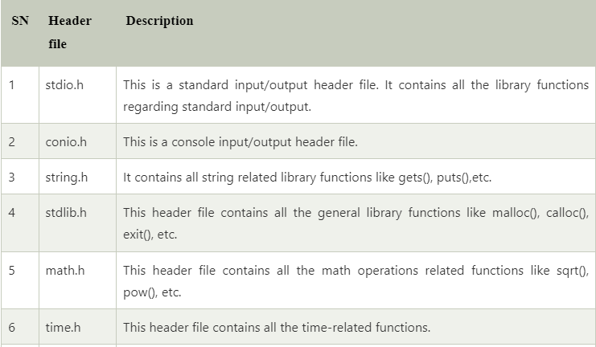
The list of mostly used header files is given in the following table.

Slide 22
C Library math.h Functions
The math.h header defines various C mathematical functions and one macro. All the functions available in this library take double as an argument and return double as the result.
Let us discuss some important C math functions one by one.

Slide 23
1 - double sqrt(double x)
The C library function double sqrt(double x) returns the square root of x.
Syntax
double sqrt(double x);
Example –
#include <stdio.h>
#include <math.h>
int main()
{
printf("Square root of %lf is %lf\n", 225.0, sqrt(225.0));
printf("Square root of %lf is %lf\n", 300.0, sqrt(300.0));
return (0);
}

Slide 24
2 - double pow(double x, double y)
The C library function double pow(double x, double y) returns x raised to the power of y i.e. xy.
Syntax
double pow(double x, double y);
Example –
#include <math.h>
#include <stdio.h>
int main()
{
printf("Value 8.0 ^ 3 = %lf\n", pow(8.0, 3));
printf("Value 3.05 ^ 1.98 = %lf", pow(3.05, 1.98));
return (0);
}

Slide 25
3 - double ceil (double x)
The C library function double ceil (double x) returns the smallest integer value greater than or equal to x.
Syntax
double ceil(double x);
Example –
#include <math.h>
#include <stdio.h>
int main()
{
float val1, val2, val3, val4;
val1 = 1.6;
val2 = 1.2;
val3 = -2.8;
val4 = -2.3;
printf("value1 = %.1lf\n", ceil(val1));
printf("value2 = %.1lf\n", ceil(val2));
printf("value3 = %.1lf\n", ceil(val3));
printf("value4 = %.1lf\n", ceil(val4));
return (0);
}
Notes:
Output –
value1 = 2.0
value2 = 2.0
value3 = -2.0
value4 = -2.0

Slide 26
4 - double floor(double x)
The C library function double floor(double x) returns the largest integer value less than or equal to x.
Syntax
double floor(double x);
Example –
#include <math.h>
#include <stdio.h>
int main()
{
float val1, val2, val3, val4;
val1 = 1.6;
val2 = 1.2;
val3 = -2.8;
val4 = -2.3;
printf("Value1 = %.1lf\n", floor(val1));
printf("Value2 = %.1lf\n", floor(val2));
printf("Value3 = %.1lf\n", floor(val3));
printf("Value4 = %.1lf\n", floor(val4));
return (0);
}
Notes:
Output –
Value1 = 1.0
Value2 = 1.0
Value3 = -3.0
Value4 = -3.0

Slide 27
5 - double fabs(double x)
The C library function double fabs(double x) returns the absolute value of x.
Syntax
syntax : double fabs(double x)
#include <math.h>
#include <stdio.h>
int main()
{
int a, b;
a = 1234;
b = -344;
printf("The absolute value of %d is %lf\n", a, fabs(a));
printf("The absolute value of %d is %lf\n", b, fabs(b));
return (0);
}

Slide 28
6 - double log(double x)
The C library function double log(double x) returns the natural logarithm (base-e logarithm) of x.
Syntax
double log(double x)
#include <math.h>
#include <stdio.h>
int main()
{
double x, ret;
x = 2.7;
/* finding log(2.7) */
ret = log(x);
printf("log(%lf) = %lf", x, ret);
return (0);
}

Slide 29
7 - double log10(double x)
The C library function double log10(double x) returns the common logarithm (base-10 logarithm) of x.
Syntax
double log10(double x);
8 - double fmod(double x, double y)
The C library function double fmod(double x, double y) returns the remainder of x divided by y.
Syntax
double fmod(double x, double y)
#include <math.h>
#include <stdio.h>
int main()
{
float a, b;
int c;
a = 8.2;
b = 5.7;
c = 3;
printf("Remainder of %f / %d is %lf\n", a, c, fmod(a, c));
printf("Remainder of %f / %f is %lf\n", a, b, fmod(a, b));
return (0);
}
Refer to https://www.geeksforgeeks.org/c-library-math-h-functions/ for more details.
Notes:
Output
Remainder of 8.200000 / 3 is 2.200000
Remainder of 8.200000 / 5.700000 is 2.500000

Slide 30
C Recursion
Recursion is the process of a function calling itself repeatedly till the given condition is satisfied.
A function that calls itself directly or indirectly is called a recursive function and such kind of function calls are called recursive calls.
We can solve large numbers of problems using recursion in C. For example, factorial of a number, generating Fibonacci series, generating subsets, etc.

Slide 31
Recursive Functions in C
In C, a function that calls itself is called Recursive Function. The recursive functions contain a call to themselves somewhere in the function body.
Basic Structure of Recursive Functions
The basic syntax structure of the recursive functions is:
type function_name (args) { // function statements // base condition // recursion case (recursive call) }

Slide 32
Example: C Program to Implement Recursion
In the below C program, recursion is used to calculate the sum of the first N natural numbers.
// C Program to calculate the sum of first N natural numbers
// using recursion
#include <stdio.h>
int nSum(int n)
{
// base condition to terminate the recursion when N = 0
if (n == 0) {
return 0;
}
// recursive case / recursive call
int res = n + nSum(n - 1);
return res;
}
int main()
{
int n = 5;
// calling the function
int sum = nSum(n);
printf("Sum of First %d Natural Numbers: %d", n, sum);
return 0;
}

Slide 33
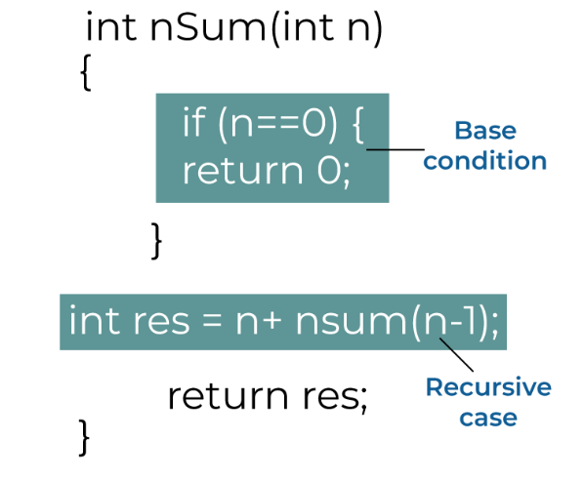
Fundamentals of C Recursion
Recursion Case
Base Condition

Slide 34
1. Recursion Case
The recursion case refers to the recursive call present in the recursive function. It decides what type of recursion will occur and how the problem will be divided into smaller subproblems.
int res = n + nSum(n - 1);
2. Base Condition
The base condition specifies when the recursion is going to terminate. It is the condition that determines the exit point of the recursion.
Note: It is important to define the base condition before the recursive case otherwise, the base condition may never encountered and recursion might continue till infinity.
Considering the above example again, the base condition defined for the nSum() function:
if (n == 0) { return 0; }

Slide 35
How Recursion works in C?
To understand how C recursion works, we will again refer to the example above and trace the flow of the program. In the nSum() function, Recursive Case is
int res = n + nSum(n - 1); In the example, n = 5, so as nSum(5)’s recursive case, we get
int res = 5 + nSum(4); In nSum(4), the recursion case and everything else will be the same, but n = 4. Let’s evaluate the recursive case for n = 4,
int res = 4 + nSum(3); Similarly, for nSum(3), nSum(2) and nSum(1)
int res = 3 + nSum(2); // nSum(3) int res = 2 + nSum(1); // nSum(2) int res = 1 + nSum(0); // nSum(1) Let’s not evaluate nSum(0) and further for now.
Now recall that the return value of the nSum() function in this same integer named res. So, instead of the function, we can put the value returned by these functions. As such, for nSum(5), we get
int res = 5 + 4 + nSum(3); Similarly, putting return values of nSum() for every n, we get
int res = 5 + 4 + 3 + 2 + 1 + nSum(0);

Slide 36
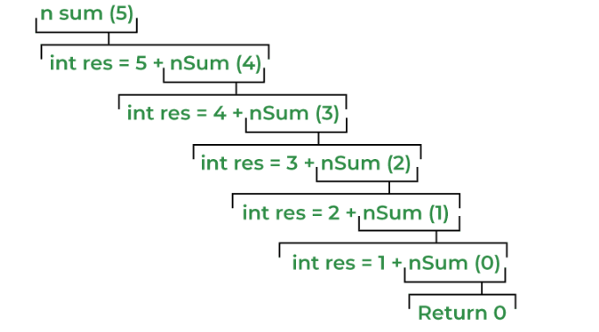
In nSum() function, the base condition is
if (n == 0) { return 0; } which means that when nSum(0) will return 0. Putting this value in nSum(5)’s recursive case, we get
int res = 5 + 4 + 3 + 2 + 1 + 0 = 15 At this point, we can see that there are no function calls left. So the recursion will stop here and the final value returned by the function will be 15 which is the sum of the first 5 natural numbers.

Slide 37
Advantages of C Recursion
Recursion can effectively reduce the length of the code.
Some problems are easily solved by using recursion like the tower of Hanoi and tree traversals.
Data structures like linked lists, trees, etc. are recursive by nature so recursive methods are easier to implement for these data structures.

Slide 38
Disadvantages of C Recursion
Recursive functions make our program a bit slower due to function call overhead.
Recursion functions always take extra space in the function call stack due to separate stack frames.
Recursion methods are difficult to understand and implement.

Slide 39
Factorial of a number –
#include<stdio.h>
int factorial(int n)
{
if (n == 0)
return 1;
else
return(n * factorial(n-1));
}
int main()
{
int number;
int fact;
printf("Enter a number: ");
scanf("%d", &number);
fact = factorial(number);
printf("Factorial of %d is %d\n", number, fact);
return 0;
}

Slide 40
Write a program in C to print the Fibonacci Series using recursion
#include<stdio.h>
void printFibonacci(int n){
static int n1=0,n2=1,n3;
if(n>0){
n3 = n1 + n2;
n1 = n2;
n2 = n3;
printf("%d ",n3);
printFibonacci(n-1);
}
}
int main(){
int n;
printf("Enter the number of elements: ");
scanf("%d",&n);
printf("Fibonacci Series: ");
printf("%d %d ",0,1);
printFibonacci(n-2);//n-2 because 2 numbers are already printed
return 0;
}
Notes:
Static variable - A static variable possesses the property of preserving its actual value even after it is out of its scope. Thus, the static variables are able to preserve their previous value according to their previous scope, and one doesn't need to initialize them again in the case of a new scope.

Slide 41
Write a program in C to count the digits of a given number using recursion.
#include <stdio.h>
//function to count digits
int countDigits(int num)
{
static int count=0;
if(num>0)
{
count++;
countDigits(num/10);
}
else
{
return count;
}
}
int main()
{
int number;
int count;
printf("Enter a positive integer number: ");
scanf("%d",&number);
count=countDigits(number);
printf("Total digits in number %d is: %d\n",number,count);
return 0;
}

Slide 42
Storage Classes in C
C Storage Classes are used to describe the features of a variable/function. These features basically include the scope, visibility, and lifetime which help us to trace the existence of a particular variable during the runtime of a program.

Slide 43
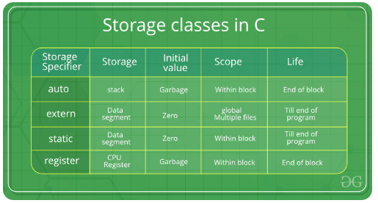
C language uses 4 storage classes, namely:

Slide 44
1. auto
Automatic variables are allocated memory automatically at runtime.
The scope of the automatic variables is limited to the block in which they are defined.
The automatic variables are initialized to garbage by default.
The memory assigned to automatic variables gets freed upon exiting from the block.
The keyword used for defining automatic variables is auto.
Every local variable is automatic in C by default.

Slide 45
Example 1 –
#include <stdio.h>
int main()
{
auto int a;
auto char b;
auto float c; //by default auto
printf("%d %c %f",a,b,c); // printing initial default value of automatic variables a, b, and c.
return 0;
}
Output - 12981640 0.000000

Slide 46
Example 2 –
#include <stdio.h>
int main()
{
{
auto int a = 10;
printf("value of a = %d", a); // 10
}
auto int a = 20;
printf("value of a = %d", a); // 20
return 0;
}

Slide 47
Static
The variables defined as static specifier can hold their value between the multiple function calls.
Static local variables are visible only to the function or the block in which they are defined.
A same static variable can be declared many times but can be assigned at only one time.
Default initial value of the static integral variable is 0 otherwise null.

Slide 48
Example 1-
#include <stdio.h>
int main()
{
static int a;
static char b;
static float c;
printf("a = %d, b = %c, d = %f", a, b, c);
return 0;
}
Output -- a = 0, b = , d = 0.000000

Slide 49
Example2 - Write a program in C to count the digits of a given number using recursion.
#include <stdio.h>
//function to count digits
int countDigits(int num)
{
static int count=0;
if(num>0)
{
count++;
countDigits(num/10);
}
else
{
return count;
}
}
int main()
{
int number;
int count;
printf("Enter a positive integer number: ");
scanf("%d",&number);
count=countDigits(number);
printf("Total digits in number %d is: %d\n",number,count);
return 0;
}

Slide 50
Register –
This storage class declares register variables that have the same functionality as that of the auto variables.
The only difference is that the compiler tries to store these variables in the register of the microprocessor if a free register is available.
This makes the use of register variables to be much faster than that of the variables stored in the memory during the runtime of the program.
If a free register is not available, these are then stored in the memory only.
Usually, a few variables which are to be accessed very frequently in a program are declared with the register keyword which improves the running time of the program.
An important and interesting point to be noted here is that we cannot obtain the address of a register variable using pointers.

Slide 51
Example 1 –
#include <stdio.h>
int main()
{
register int a;
register char b;
register float c;
printf("a = %d, b = %c, d = %f", a, b, c);
return 0;
}
Output - a = 3579904, b = , d = 0.000000
Example 2 –
#include <stdio.h>
int main()
{
register int a = 0;
printf("%u",&a); // This will give a compile time error since we can not access the address of a register variable.
}

Slide 52
Extern -
Extern storage class simply tells us that the variable is defined elsewhere and not within the same block where it is used.
Basically, the value is assigned to it in a different block and this can be overwritten/changed in a different block as well.
So an extern variable is nothing but a global variable initialized with a legal value where it is declared in order to be used elsewhere. It can be accessed within any function/block.

Slide 53
Example 1 –
#include <stdio.h>
int main()
{
extern int a;
printf("%d",a);
}
Output - main.c:(.text+0x6): undefined reference to `a' collect2: error: ld returned 1 exit status
Example2 –
#include <stdio.h>
int a;
int main()
{
extern int a; // variable a is defined globally, the memory will not be allocated to a
printf("%d",a);
}
Output - 0

Slide 54
Example 3
#include <stdio.h>
int a;
int main()
{
extern int a = 0; // this will show a compiler error since we can not use extern and initializer at same time
printf("%d",a);
}
compile time error

Slide 55
Example 4
#include <stdio.h>
int main()
{
extern int a; // Compiler will search here for a variable a defined and initialized somewhere in the program or not.
printf("%d",a);
}
int a = 20;
Output
20

